Slide 1


Course – Theoretical Foundations of Computations
Course Instructor
Dr. Umadevi V
Department of CSE, BMSCE
Webpage:https://sites.google.com/site/drvumadevi/

Slide 2
Unit-1
Introduction to Finite Automata
Introduction to Finite Automata, Central Concepts of Automata Theory, Deterministic Finite Automata (DFA), Nondeterministic Finite Automata (NFA), Finite Automata with Epsilon Transition, An Application Text Search.

Slide 3
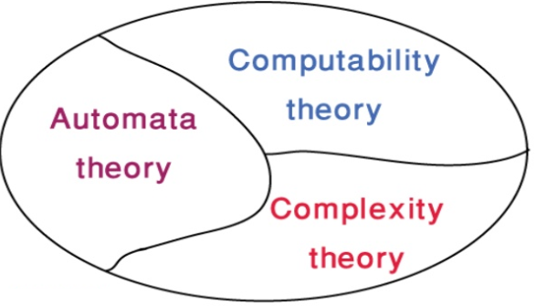
Theory of Computation
The field is divided into Three major Branches

Slide 4
What is automata theory ?
Automata theory is the study of abstract computational devices
Abstract devices are (simplified) models of real computations
Computations happen everywhere: On your laptop, on your cell phone, in nature, …
Why do we need abstract models?

Slide 5
Finite State machine
Abstract machine or Automata or Finite State machine
Example:
Event1/
Action1
Notations
State1
State3
Start State
Event3/
Action3
Event2/
Action2
State
State2
Final State
Nodes: State
Edges: Transition
Edge Label: Events / Actions

Slide 6
A simple computer
SWITCH
BATTERY
input: switch
output: light bulb
actions: flip switch
states: on, off

Slide 7
A simple “computer”
SWITCH
Abstract machine or
Automaton
f
BATTERY
start
on
off
f
input: switch
output: light bulb
actions: f for “flip switch”
states: on, off
bulb is on if and only if there was an odd number of flips

Slide 8
Another “computer”
1
BATTERY
2

Slide 9
Another “computer”
1
1
start
off
off
BATTERY
2
2
off
on
inputs: switches 1 and 2
actions: 1 for “flip switch 1”
actions: 2 for “flip switch 2”
states: on, off
bulb is on if and only if both switches were flipped an odd number of times

Slide 10
Another “computer”
1
1
start
off
off
1
BATTERY
2
2
2
2
1
2
off
on
1
inputs: switches 1 and 2
actions: 1 for “flip switch 1”
actions: 2 for “flip switch 2”
states: on, off
bulb is on if and only if both switches were flipped an odd number of times

Slide 11
A design problem
1
?
4
5
BATTERY
2
3
Can you design a circuit where the light is on if and only if all the switches were flipped exactly the same number of times?

Slide 12
A design problem
Such devices are difficult to reason about, because they can be designed in an infinite number of ways
By representing them as abstract computational devices, or automata, we will learn how to answer such questions

Slide 13
Applications of Automata Theory
In Compiler: Lexical analyzers and Parser generator
Word search and Translation of Natural Languages
Parity checkers, Vending machines, Communication protocols, Video games, Artificial Intelligence etc.

Slide 14
Different kinds of automata we will work on in this course
Finite Automata | Devices with a finite amount of memory. Used to model “small” computers.
Push-down Automata | Devices with infinite memory that can be accessed in a restricted way. Used to model Parsers, etc.
Turing Machines | Devices with infinite memory. Used to model any computer.

Slide 15
The Applications of these Automata are given as follows:
1. Finite Automata (FA) –
For the designing of lexical analysis of a compiler.
For recognizing the pattern using regular expressions.
For the designing of the combination and sequential circuits using Mealy and Moore Machines.
Used in text editors.
For the implementation of spell checkers.
2. Push Down Automata (PDA) –
For designing the parsing phase of a compiler (Syntax Analysis).
For implementation of stack applications.
For evaluating the arithmetic expressions.
For solving the Tower of Hanoi Problem.
3. Turing Machine (TM) –
For solving any recursively enumerable problem.
For understanding complexity theory.
For implementation of neural networks.
For implementation of Robotics Applications.
For implementation of artificial intelligence.

Slide 16
Unit-1
Central Concepts of Automata Theory
- Alphabets
- Strings
- Languages

Slide 17
Central Concepts
Symbol
A symbol is a single object and is an abstract entity that has no meaning by itself.
It can be alphabet, character or special character

Slide 18
Central Concepts
Alphabet
An alphabet is a finite, nonempty set of symbols, Σ (sigma) is used for an alphabet.
For example
{0, 1} is an alphabet with two symbols
{a, b} is another alphabet with two symbols, and
English alphabet is also an alphabet
Σ = {0,1}, or Σ = the binary alphabet
Σ = {a,b,…..z}, or Σ=the set of all lower-case letters

Slide 19
Central Concepts: String
A string is a finite sequence of symbols chosen from some alphabet. e.g. 01101 is a string from the binary alphabet Σ = {0,1}.
The number of symbols in a string is called the length of a string. e.g. 011101 has length 5 and the number of symbols are 2. The standard notation for the length of a string w is |w|. e.g. |011| = 3

Slide 20
Central Concepts: String
The empty string (also called null string) is the string with length zero. That is, it has no symbols. It is denoted with ε (epsilon), that may be chosen from any alphabet whatsoever. Thus | ε | = 0.

Slide 21
Central Concepts: String
Powers of an Alphabet: If Σ is an alphabet, we define Σ^{k} to be the set of strings of length k, each of whose symbols is in Σ. e.g. Σ⁰ = {ε}.
If Σ = {0,1}, then
Σ¹ = {0,1}
Σ² = {00,01,10,11}
Σ³ = {000,001,010,011,100,101,110,111}
The set of all strings over an alphabet is denoted as Σ*. For instance, {0,1}* = {ε,0,1,00,01,10,11,000,….}. Put another way,
Σ* = Σ⁰ U Σ¹ U Σ² U Σ³ ….
Σ⁺ = Σ¹ U Σ² U Σ³ ….

Slide 22
Central Concepts
Strings
Concatenation of Strings: Let x and y be strings. Then xy denotes the string obtained by concatenating x with y, that is, xy is the string obtained by appending the sequence os symbols of y to that of x. e.g. if x = aab and y = bbab, then xy = aabbbab. Note that xy ≠ yx.

Slide 23
Central Concepts
Languages
A language is a set of strings over an alphabet. Thus {a, ab, baa} is a language (over alphabet {a, b}).
A set of strings all of which are chosen from some Σ*, where Σ is a particular alphabet, is called a language. If Σ is an alphabet, and L Σ* , then L is a language over Σ.
An example is English, where the collection of legal English words is a set of strings over the alphabet that consists of all the letters.

Slide 24
Question
Consider the alphabet set as Σ ={0,1}. Write down possible strings of the Language, L, which is defined as follows:
L={w | w consists of equal number of 0’s and 1’s}

Slide 25
Question
Consider the alphabet set as Σ ={0,1}. Write down possible strings of the Language, L, which is defined as follows:
L={w | w consists of equal number of 0’s and 1’s}
Answer:
L={ε, 01, 10, 1100, 0011, 0101, 1010, 0011010,……..}

Slide 26
Examples of Languages
The language of all strings consisting of n 0’s followed by n 1’s, for some n ≥ 0:
{ε, 01, 0011, 000111,…..}
The set of strings of 0’s and 1’s with an equal number of each:
{ε, 01,10,0011,0101,1001,…..}
The set of binary numbers whose value is a prime:
{10, 11, 101,111,1011…..}
Note: The only important constraint on what can be a language is that all alphabets are finite, although they can have an infinite number of strings.

Slide 27
Summarizing
Central Concepts
Alphabet: A set of Symbols
Strings: A list of symbols from an alphabet
Language: A set of strings from the same alphabet.

Slide 28
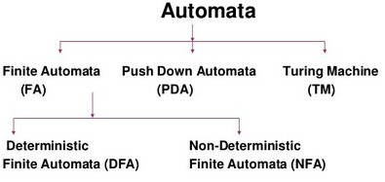
Types of Finite Automata

Slide 29
Formal Definition of Deterministic Finite Automata
A Deterministic Finite Automaton (DFA) is a 5-tuple system
M= (Q, Σ, δ, q₀, F) where
Q is a finite set of states
Σ is an alphabet set or input symbols
δ: Q × Σ → Q is a transition function
q₀ ∈ Q is the initial (or start)state
F ⊆ Q is a set of accepting states (or final states).
q₀
q

Slide 30
Question
Construct a Deterministic Finite Automata (DFA) to recognize all odd number a’s given the alphabet set as Σ ={a}
Note: For DFA construction specific steps to be followed cannot be generalized for all computational problems.
But to get started, we will follow some steps. This steps may not be applicable to all DFA’. But, it helps to get started.

Slide 31
Construct a Deterministic Finite Automata (DFA) to recognize all odd number a’s given the alphabet set as Σ ={a}
Step1: Write possible strings of the Language that will be accepted for the given DFA
L={a, aaa, aaaaa,……}

Slide 32
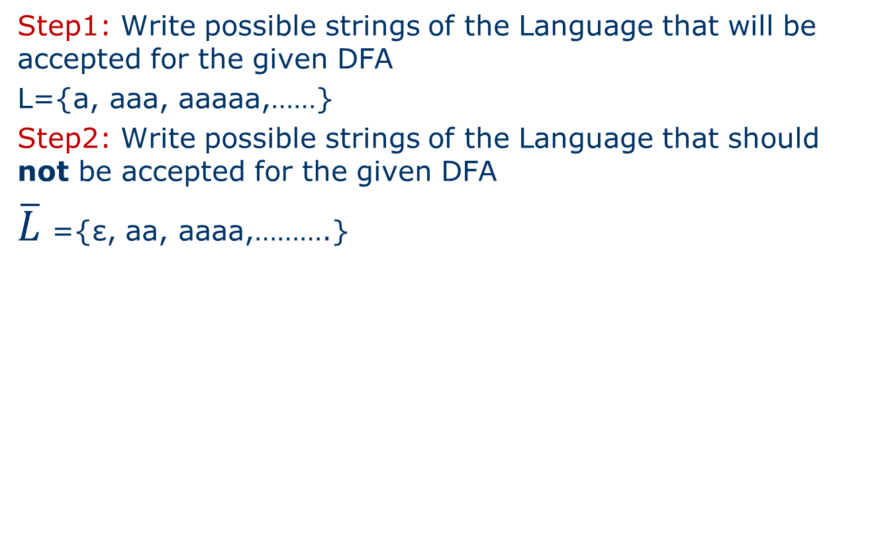
Construct a Deterministic Finite Automata (DFA) to recognize all odd number a’s given the alphabet set as Σ ={a}
Step1: Write possible strings of the Language that will be accepted for the given DFA
L={a, aaa, aaaaa,……}
Step2: Write possible strings of the Language that should not be accepted for the given DFA
$\overline{L}$ ={ε, aa, aaaa,……….}

Slide 33
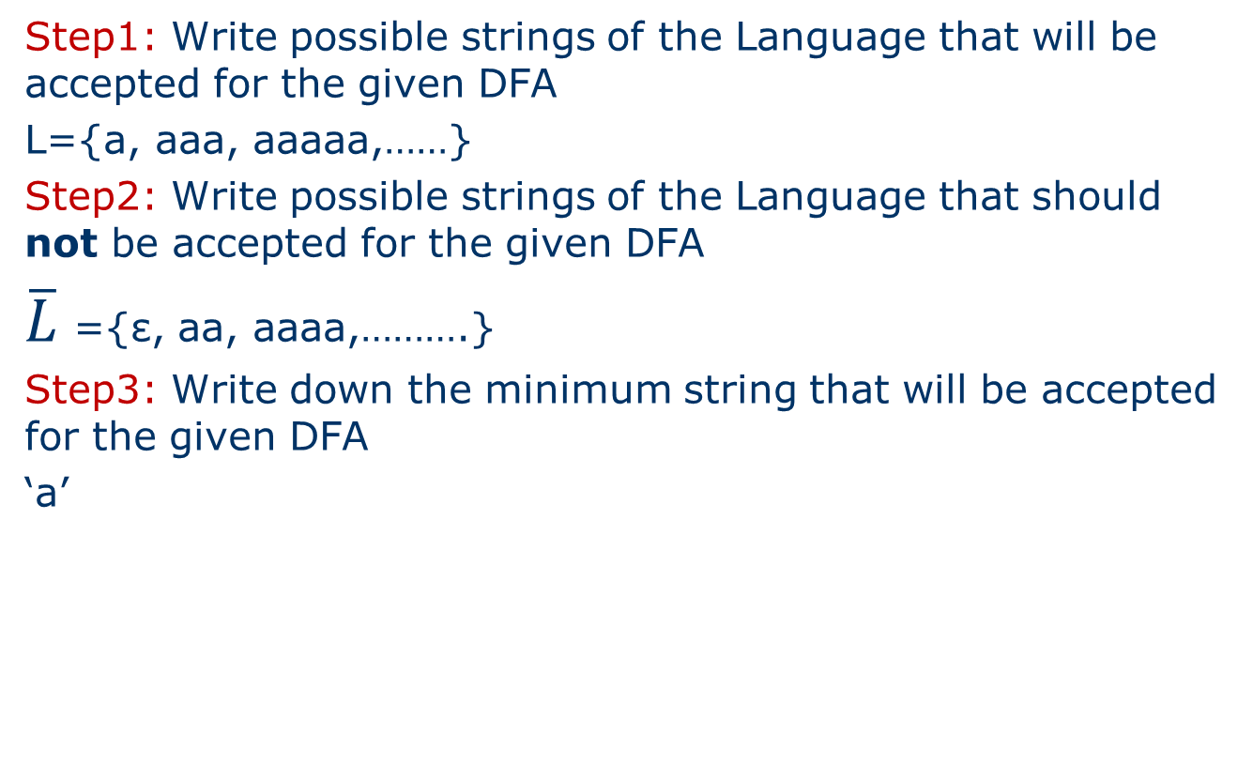
Construct a Deterministic Finite Automata (DFA) to recognize all odd number a’s given the alphabet set as Σ ={a}
Step1: Write possible strings of the Language that will be accepted for the given DFA
L={a, aaa, aaaaa,……}
Step2: Write possible strings of the Language that should not be accepted for the given DFA
$\overline{L}$ ={ε, aa, aaaa,……….}
Step3: Write down the minimum string that will be accepted for the given DFA
‘a’

Slide 34
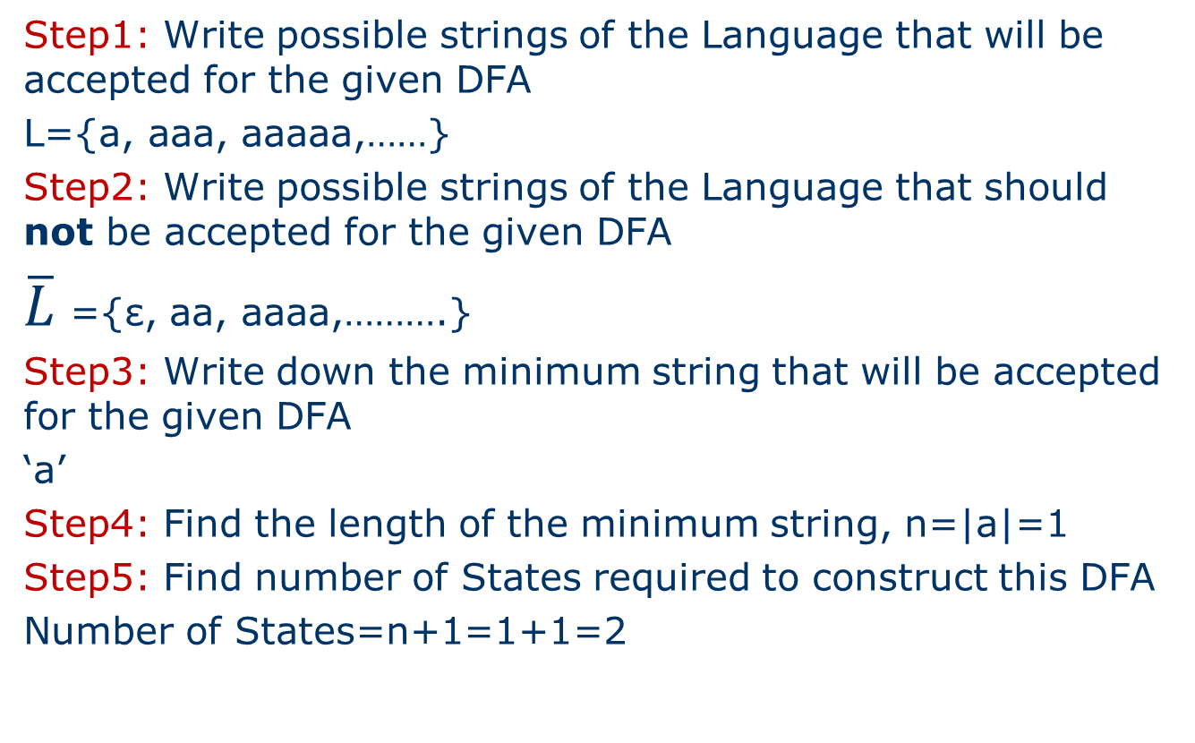
Construct a Deterministic Finite Automata (DFA) to recognize all odd number a’s given the alphabet set as Σ ={a}
Step1: Write possible strings of the Language that will be accepted for the given DFA
L={a, aaa, aaaaa,……}
Step2: Write possible strings of the Language that should not be accepted for the given DFA
$\overline{L}$ ={ε, aa, aaaa,……….}
Step3: Write down the minimum string that will be accepted for the given DFA
‘a’
Step4: Find the length of the minimum string, n=|a|=1
Step5: Find number of States required to construct this DFA
Number of States=n+1=1+1=2

Slide 35
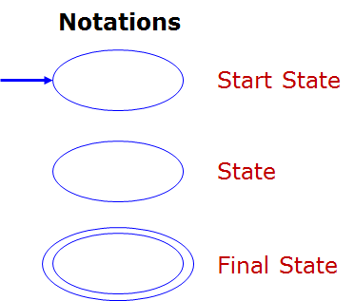
Construct a Deterministic Finite Automata (DFA) to recognize all odd number a’s given the alphabet set as Σ ={a}
Step6: Draw the transition diagram of the DFA that accepts minimum string. Note: Make sure that there in one Start State and atleast one final state
q₀
a
q₁

Slide 36
Construct a Deterministic Finite Automata (DFA) to recognize all odd number a’s given the alphabet set as Σ ={a}
Step6: Draw the transition diagram of the DFA that accepts minimum string. Note: Make sure that there in one Start State and atleast one final state
Step7: For the basic DFA, defined in Step6, consider one state at a time and obtain the various missing transitions on each input symbol
q₀
a
q₁
q₀
a
q₁
a

Slide 37
Construct a Deterministic Finite Automata (DFA) to recognize all odd number a’s given the alphabet set as Σ ={a}
Step8: For the missing transitions identified in step7, connect this transitions to appropriate state so that the string stated in the problem is accepted.
a
q₀
q₁
Transition Diagram
a

Slide 38
Construct a Deterministic Finite Automata (DFA) to recognize all odd number a’s given the alphabet set as Σ ={a}
Step8: For the missing transitions identified in step7, connect this transitions to appropriate state so that the string stated in the problem is accepted.
Step9: Write the formal definition of DFA
M= (Q, Σ, δ, q₀, F) where
Q ={q₀,q₁} Finite set of states
Σ ={a} Alphabet set or input symbols
q₀ = q₀ Initial (or start) state
F ={q₁} Accepting states (or Final states).
δ: Q × Σ → Q is a transition function
a
q₀
q₁
Transition Diagram
a
Transition Table
δ | a
q₀ | q₁
q₁ | q₀

Slide 39
Construct a Deterministic Finite Automata (DFA) to recognize all odd number a’s given the alphabet set as Σ ={a}
Step10: Consider any one string which will be accepted and one string which should not accepted by this DFA defined in the step9. Show the transition function movements for these strings.
δ(q₀, aaa)=δ(q₁, aa)=δ(q₀, a)= q₁ ∈ F, Final state
Hence string aaa is accepted
Transition Table
δ | a
q₀ | q₁
q₁ | q₀

Slide 40
Construct a Deterministic Finite Automata (DFA) to recognize all odd number a’s given the alphabet set as Σ ={a}
Step10: Consider any one string which will be accepted and one string which should not accepted by this DFA defined in the step9. Show the transition function movements for these strings.
δ(q₀, aaa)=δ(q₁, aa)=δ(q₀, a)= q₁ ∈ F, Final state
Hence string aaa is accepted
δ(q₀, aa)=δ(q₁, a)=q₀ ∉ F, Final state
Hence string aa is not accepted
Transition Table
δ | a
q₀ | q₁
q₁ | q₀

Slide 41
Question
Construct a Deterministic Finite Automata (DFA) that accepts set of all strings having aa as a substring. Consider the alphabet set as Σ ={a,b}

Slide 42
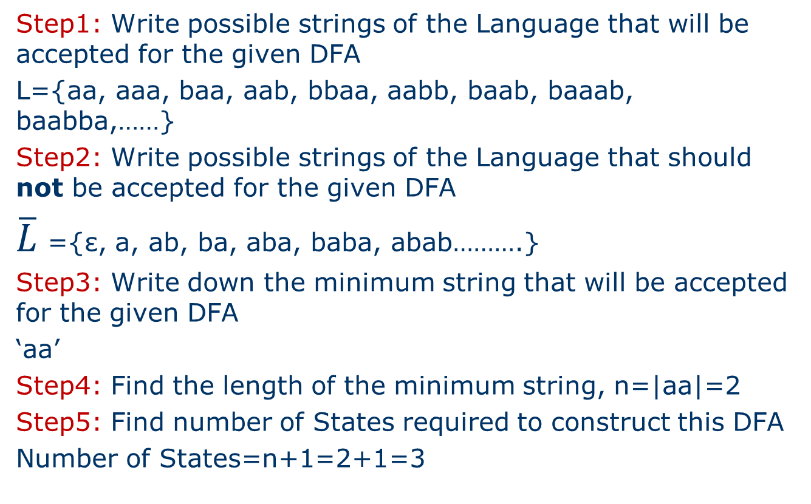
Construct a Deterministic Finite Automata (DFA) that accepts set of all strings having aa as a substring. Consider the alphabet set as Σ ={a,b}
Step1: Write possible strings of the Language that will be accepted for the given DFA
L={aa, aaa, baa, aab, bbaa, aabb, baab, baaab, baabba,……}
Step2: Write possible strings of the Language that should not be accepted for the given DFA
$\overline{L}$ ={ε, a, ab, ba, aba, baba, abab……….}
Step3: Write down the minimum string that will be accepted for the given DFA
‘aa’
Step4: Find the length of the minimum string, n=|aa|=2
Step5: Find number of States required to construct this DFA
Number of States=n+1=2+1=3

Slide 43
Construct a Deterministic Finite Automata (DFA) that accepts set of all strings having aa as a substring. Consider the alphabet set as Σ ={a,b}
Step6: Draw the transition diagram of the DFA that accepts minimum string. Note: Make sure that there in one Start State and atleast one final state
Step7: For the basic DFA, defined in Step6, consider one state at a time and obtain the various missing transitions on each input symbol
q₀
a
q₁
a
q₂
q₀
a
q₁
a
q₁
b
b
a
b

Slide 44
Construct a Deterministic Finite Automata (DFA) that accepts set of all strings having aa as a substring. Consider the alphabet set as Σ ={a,b}
Step8: For the missing transitions identified in step7, connect this transitions to appropriate state so that the string stated in the problem is accepted.
Step9: Write the formal definition of DFA
M= (Q, Σ, δ, q₀, F) where
Q ={q₀,q₁,q₂} Finite set of states
Σ ={a, b} Alphabet set or input symbols
q₀ = q₀ Initial (or start) state
F ={q₂} Accepting states (or Final states).
δ: Q × Σ → Q is a transition function
b
a
q₀
a
q₁
a
q₂
Transition Diagram
b
b
Transition Table
δ | a | b
q₀ | q₁ | q₀
q₁ | q₂ | q₀
q₂ | q₂ | q₂

Slide 45
Construct a Deterministic Finite Automata (DFA) that accepts set of all strings having aa as a substring. Consider the alphabet set as Σ ={a,b}
Step10: Consider any one string which will be accepted and one string which should not accepted by this DFA defined in the step9. Show the transition function movements for these strings.
δ(q₀, baa)=δ(q₀, aa)=δ(q₁, a)= q₂ ∈ F, Final state
Hence string baa is accepted
δ(q₀, aba)=δ(q₁, ba)=δ(q₀, a)=q₁ ∉ F, Final state
Hence string aba is not accepted
Transition Table
δ | a | b
q₀ | q₁ | q₀
q₁ | q₂ | q₀
q₂ | q₂ | q₂

Slide 46
Questions
Construct DFA’s accepting the following strings over the alphabet set Σ ={0,1}
The set of all strings ending with 00
The set of all strings with three consecutive 0’s atleast once
Set of all strings beginning with 00

Slide 47
Rough Slide to explain
Construct DFA’s accepting the following strings over the alphabet set Σ ={0,1}
The set of all strings ending with 00

Slide 48
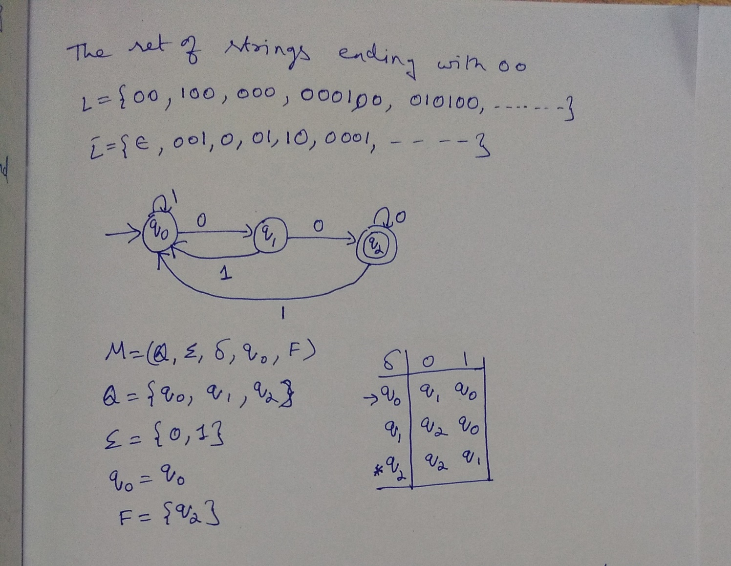
Construct DFA’s accepting the following strings over the
alphabet set Σ ={0,1}
i. The set of all strings ending with 00
q₀

Slide 49


Slide 50
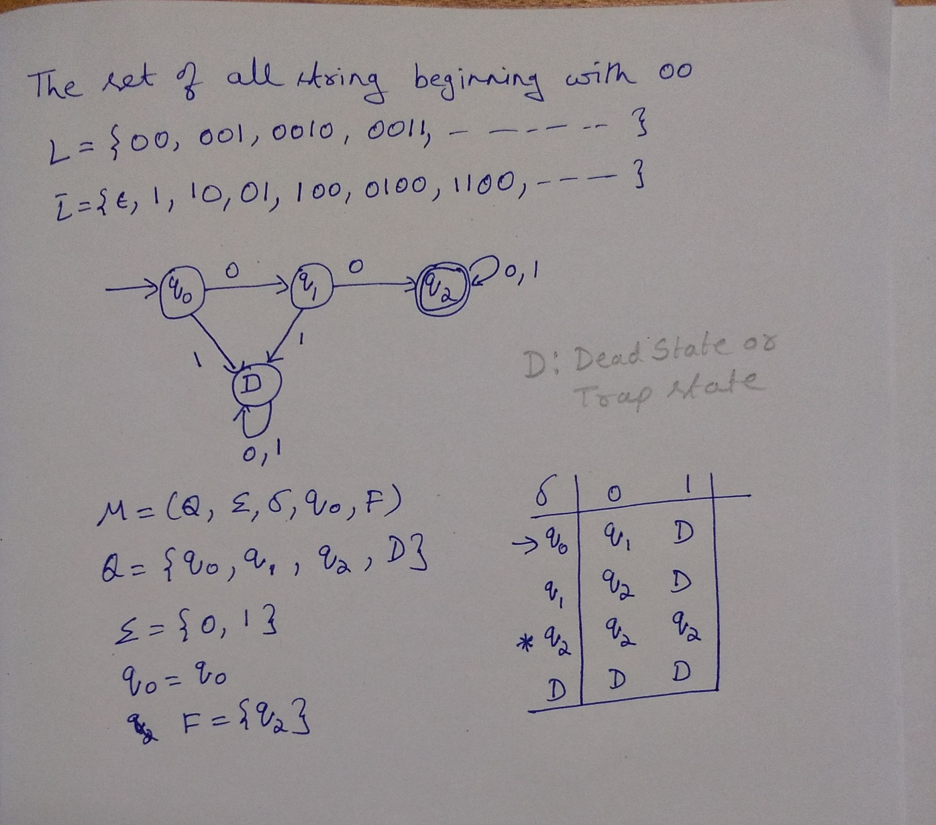

Slide 51
Questions
Construct DFA’s accepting the following strings over the alphabet set Σ ={a,b}
The set of all strings with exactly one ‘a’
The set of all strings with at least one ‘a’
Not more than three a’s in the strings
The set of all strings except those which end with ‘abb’
Set of all strings not containing the substring ‘abb’
The set of all strings either begins or ends or both with substring ‘ab’
Set of strings ending with ab or ba
Set of all strings with at least one ‘a’ and exactly two b’s

Slide 52
Questions
Construct DFA’s accepting the following strings over the alphabet set Σ ={a,b}
The set of all strings with exactly one ‘a’
The set of all strings with at least one ‘a’

Slide 53
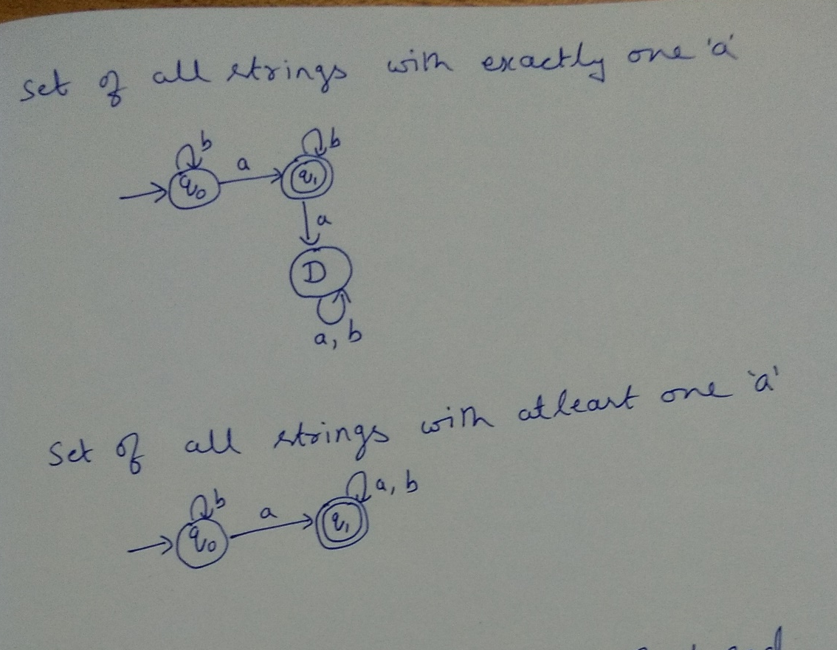
Note: For the DFA’s,
Transition diagram
Formal definition
Transition Table
Should written

Slide 54
Questions
Construct DFA’s accepting the following strings over the alphabet set Σ ={a,b}
The set of all strings with exactly one ‘a’
The set of all strings with at least one ‘a’
Not more than three a’s in the strings
The set of all strings except those which end with ‘abb’

Slide 55
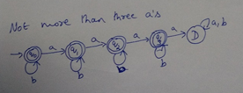
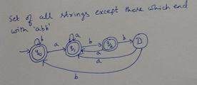
Note: For the DFA’s,
Transition diagram
Formal definition
Transition Table
Should written

Slide 56
Questions
Construct DFA’s accepting the following strings over the alphabet set Σ ={a,b}
The set of all strings with exactly one ‘a’
The set of all strings with at least one ‘a’
Not more than three a’s in the strings
The set of all strings except those which end with ‘abb’
Set of all strings not containing the substring ‘abb’
The set of all strings either begins or ends or both with substring ‘ab’

Slide 57
Rough slide to explain
Construct DFA’s accepting the following strings over the alphabet set Σ ={a,b}
Set of all strings not containing the substring ‘abb’

Slide 58
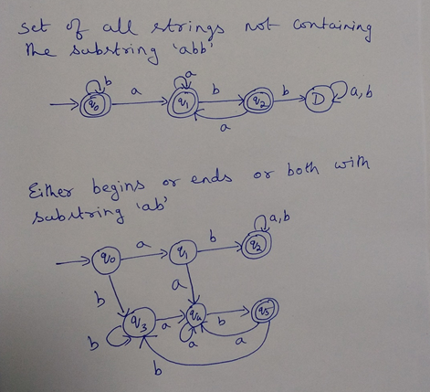

Slide 59
Rough slide to explain
Construct DFA’s accepting the following strings over the alphabet set Σ ={a,b}
The set of all strings either begins or ends or both with substring ‘ab’

Slide 61
Questions
Construct DFA’s accepting the following strings over the alphabet set Σ ={a,b}
The set of all strings with exactly one ‘a’
The set of all strings with at least one ‘a’
Not more than three a’s in the strings
The set of all strings except those which end with ‘abb’
Set of all strings not containing the substring ‘abb’
The set of all strings either begins or ends or both with substring ‘ab’
Set of strings ending with ab or ba
Set of all strings with at least one ‘a’ and exactly two b’s

Slide 62
Rough Slide to explain
Construct DFA’s accepting the following strings over the alphabet set Σ ={a,b}
Set of strings ending with ab or ba

Slide 63
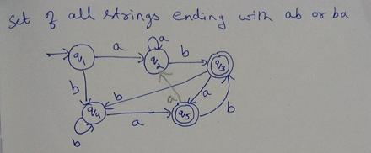
Note: For the DFA’s,
Transition diagram
Formal definition
Transition Table
Should written

Slide 64
Questions
Construct DFA’s accepting the following strings over the alphabet set Σ ={a,b}
Set of all strings with at least one ‘a’ and exactly two b’s

Slide 65
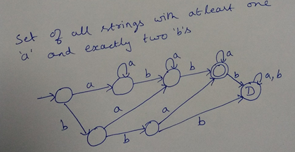
Note: For the DFA’s,
Transition diagram
Formal definition
Transition Table
Should written

Slide 66
Question
The number of states in the minimal deterministic finite automaton corresponding to the regular expression
(0 + 1)*(10) is ____________ (A) 2 (B) 3 (C) 4 (D) 5

Slide 67
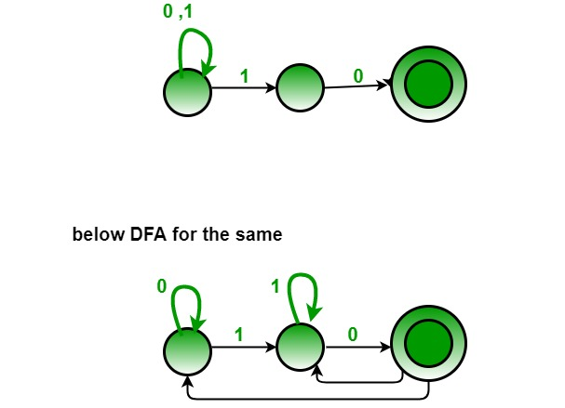
Question
The number of states in the minimal deterministic finite automaton corresponding to the regular expression (0 + 1)*(10) is ____________ (A) 2 (B) 3 (C) 4 (D) 5 Answer: (B)
1
0

Slide 68
Question
Draw a deterministic finite automata which accept a string containing “the” anywhere in a string of
Σ ={a-z}, e.g., “there” but not “those”.

Slide 69
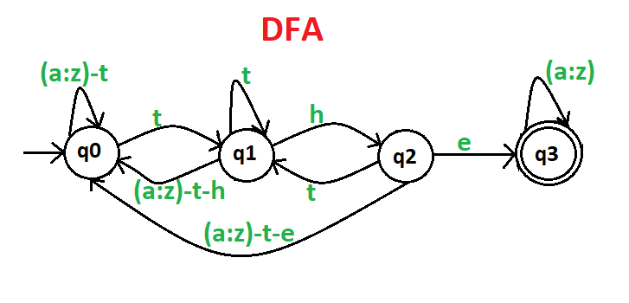
Question
Draw a deterministic finite automata which accept a string containing “the” anywhere in a string of {a-z}, e.g., “there” but not “those”.

Slide 70
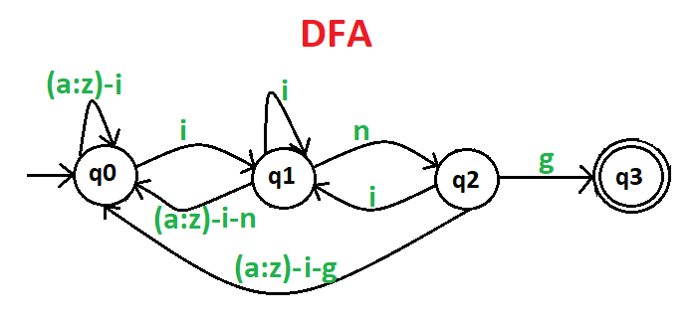
Question
Draw a deterministic and non-deterministic finite automata which accept a string containing “ing” at the end of a string in a string of {a-z}, e.g., “anything” but not “anywhere”.

Slide 71
Questions
Construct DFA for the following languages over the alphabet set Σ ={a, b}
L={awa / w∈ (a+b)∗ }
L={w / n_{a}(w) mod 3 ==0 }
L={w / |w| mod 3 ==0 }
L={w / |w| mod 5 ≠ 0 }

Slide 72
Questions
Construct DFA for the following languages over the alphabet set Σ ={a,b}
L={awa / w∈ (a+b)∗ }

Slide 73
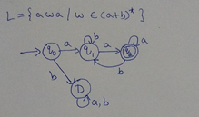
Note: For the DFA’s,
Transition diagram
Formal definition
Transition Table
Should written

Slide 74
Rough Slide to explain
Construct DFA for the following languages over the alphabet set Σ ={a, b}
L={w / n_{a}(w) mod 3 ==0 }

Slide 75
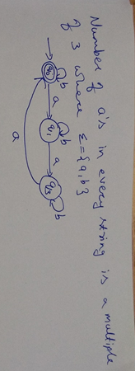
Questions
Construct DFA for the following languages over the alphabet set Σ ={a, b}
L={awa / w ∈ (a+b)∗ }
L={w / n_{a}(w) mod 3 ==0 }

Slide 76
Questions
Construct DFA for the following languages over the alphabet set Σ ={a, b}
L={awa / w∈ (a+b)∗ }
L={w / n_{a}(w) mod 3 ==0 }
L={w / |w| mod 3 ==0 }

Slide 77
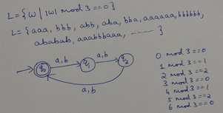
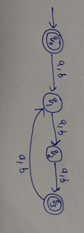
Note: For the DFA’s,
Transition diagram
Formal definition
Transition Table
Should written
OR

Slide 78
Questions
Construct DFA for the following languages over the alphabet set Σ ={a, b}
L={awa / w∈ (a+b)∗ }
L={w / n_{a}(w) mod 3 ==0 }
L={w / |w| mod 3 ==0 }
L={w / |w| mod 5 ≠ 0 }

Slide 79
Rough Slide to explain
Construct DFA for the following languages over the alphabet set Σ ={a, b}
L={w / |w| mod 5 ≠ 0 }
L={w / |w| mod 5 == 0 }

Slide 80
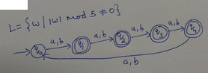
Note: For the DFA’s,
Transition diagram
Formal definition
Transition Table
Should written

Slide 81
Question
1. Construct DFA to accept even number of a’s over the alphabet set Σ ={a}
2. Construct DFA to accept odd number of a’s over the alphabet set Σ ={a}

Slide 82
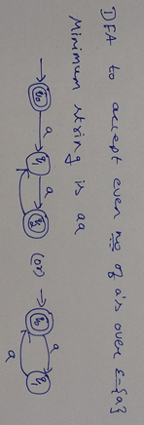
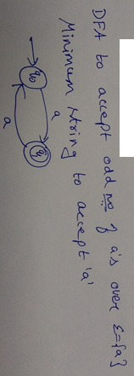
a
Notes:
Construct DFA to accept even number of a’s over the alphabet set Σ ={a}
Construct DFA to accept odd number of a’s over the alphabet set Σ ={a}

Slide 83
Questions
Construct DFA for the following language over the alphabet set Σ ={a, b}
L={w / w∈(a+b)∗ , n_{a}(w) mod 2 ==0 and n_{b}(w) mod 2 ==0 }
OR
L={w / w∈(a+b)∗ , N_{a}(w) as well as N_{b}(w) is even }
OR
To accept strings of a’s and b’s with even number of a’s and b’s

Slide 84
Rough slide to explain
Construct DFA for the following language over the alphabet set Σ ={a, b}
L={w / w∈(a+b)∗ , n_{a}(w) mod 2 ==0 and n_{b}(w) mod 2 ==0 }

Slide 85
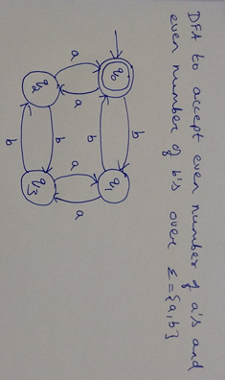
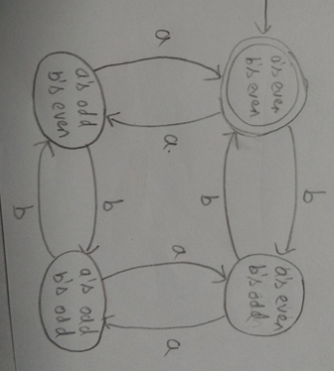
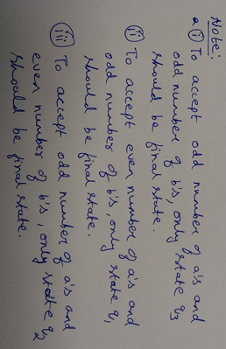

Slide 86
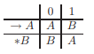
Question
Consider the DFA with the following transition table:
Informally describe the language accepted by this DFA

Slide 87
Question
Consider the DFA with the following transition table:
Informally describe the language accepted by this DFA
Answer
You should draw the transition graph before reading this answer; it will help with your understanding.
We claim that the language of the DFA is {w | w contains an odd number of 1’s}

Slide 88
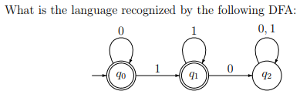
Question

Slide 89
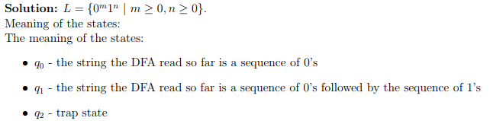
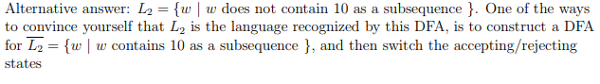
Question

Slide 90
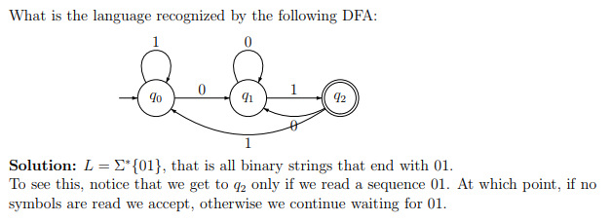
Question

Slide 91
Question

Slide 92
Question
Construct DFA for the following language over the alphabet set Σ ={0, 1}
L={w / w is even length and begins with ‘01’

Slide 93
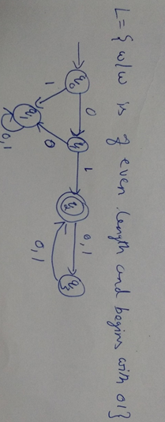
Question
Construct DFA for the following language over the alphabet set Σ ={0, 1}
L={w / w is even length and begins with ‘01’

Slide 94
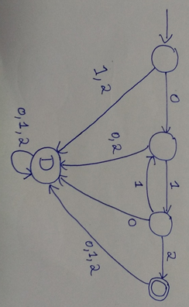
Question
Obtain a DFA to accept strings of 0’s , 1’s and 2’s beginning with a ‘0’ followed by odd number of 1’s and ending with ‘2’

Slide 95
Question
Obtain DFA to accept strings of a’s and b’s such that
L={w / w ∈ (a+b)∗ such that
N_{a}(w) mod 3 == 0 and N_{b}(w) mod 2==0}

Slide 96
Rough Slide to explain
Obtain DFA to accept strings of a’s and b’s such that
L={w / w ∈ (a+b)∗ such that
N_{a}(w) mod 3 == 0 and N_{b}(w) mod 2==0}
N_{a}(w) mod 3: { 0, 1, 2}
N_{b}(w) mod 2: { 0, 1}
So possible states of DFA
is given by cross product
Of {0,1,2} x {0,1}
Possible Remainders

Slide 97
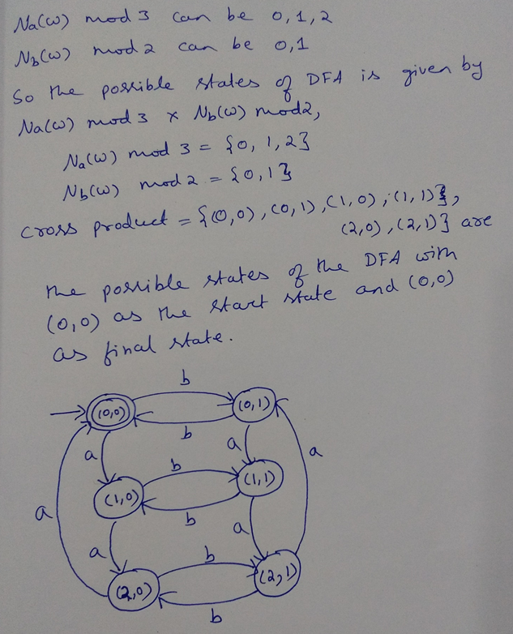

Slide 98
Question
Obtain DFA to accept strings of a’s and b’s such that
L={w / w ∈ (a+b)∗ such that
N_{a}(w) mod 5 == 0 and N_{b}(w) mod 3 ==0}

Slide 99
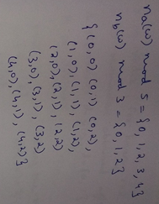
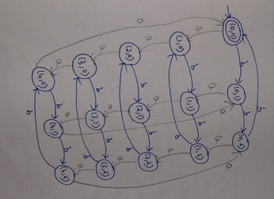

Slide 100
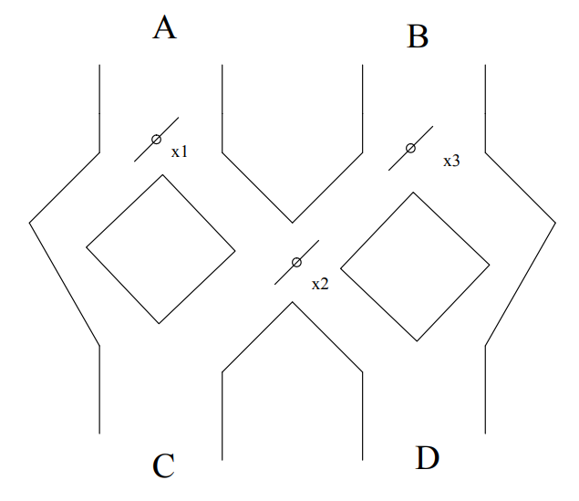
Question: Marble Rolling game
The following figure below is a marble-rolling toy. A marble is dropped at A or B. There are three levers in this figure, let’s say x1, x2 and x3 from left to right. Whenever a marble encounters a lever, it causes the lever to reverse after the marble passes, so the next marble will take the opposite branch.
Model this toy by a Deterministic finite automaton. Let the inputs A and B represent the input into which the marble is dropped. Let acceptance correspond to the marble exiting at D; non-acceptance represents a marble exiting at C.

Slide 101
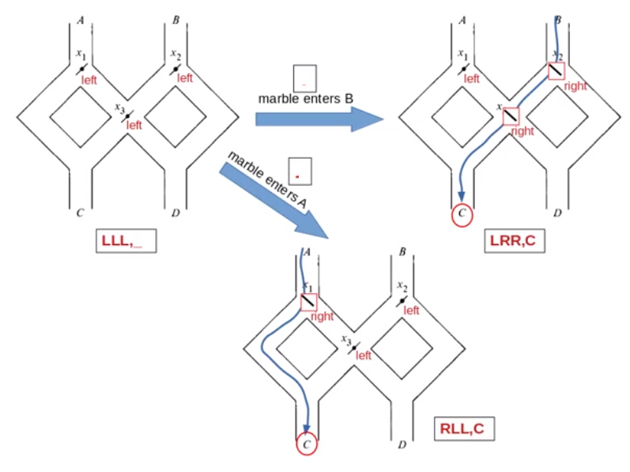
Illustration: Marble Toy example
1
0

Slide 102
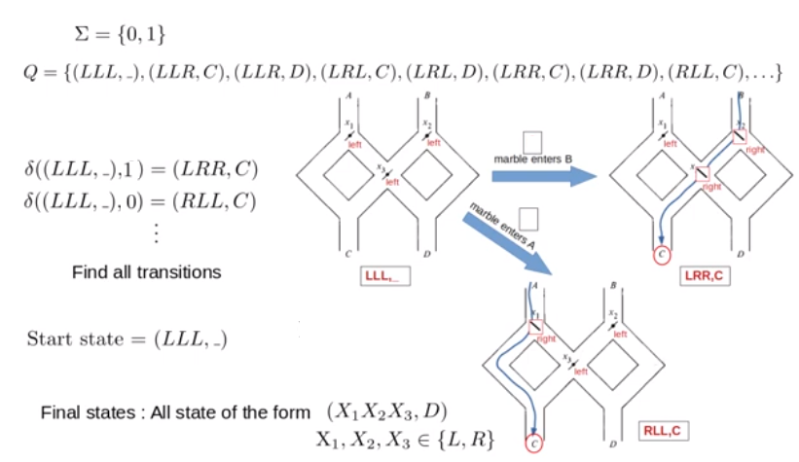
Illustration: Marble Toy example

Slide 103
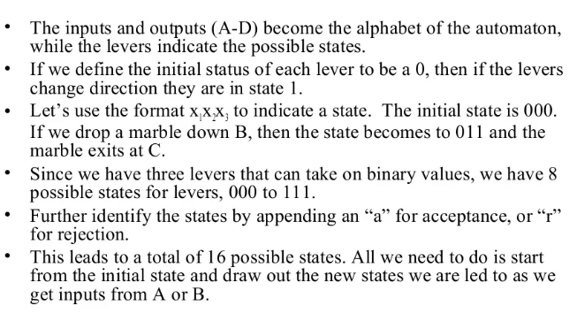
Marble Rolling game: Modelling as Finite Automata

Slide 104
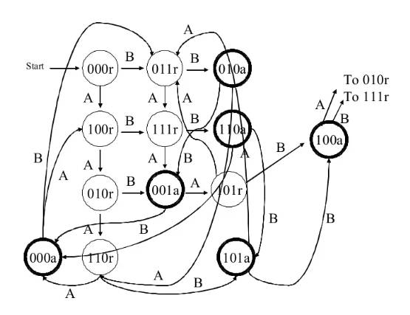
Marble Rolling game: Modelling as Finite Automata

Slide 105
Question
Construct a DFA which accepts strings of 0’s and 1’s where the values of each string is represented as a binary number only. Only the strings representing zero modulo three should be accepted. For example 0, 11, 011, 110, 1001, ……
OR
Design a DFA to accept the binary numbers which are divisible by 3

Slide 106
Design a DFA to accept the binary numbers which are divisible by 3
r is radix, For binary r=2
i is remainder obtained after dividing by k
d represents digits
k is divisor
r=2
i={0,1,2}
d={0,1}
k=3
We will use the relation, δ(q_{i} , a)=q_{j} where j=(r*i+d) mod k

Slide 107
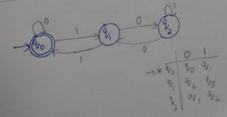
Design a DFA to accept the binary numbers which are divisible by 3
Remai-nder | d | j=(r*i+d) mod k | δ(q_{i} , a)=q_{j}
i=0 | 0 | j=(2*0+0) mod 3=0 | δ(q₀ , 0)=q₀
 | 1 | j=(2*0+1) mod 3=1 | δ(q₀ , 1)=q₁
i=1 | 0 | j=(2*1+0) mod 3=2 | δ(q₁ , 0)=q₂
 | 1 | j=(2*1+1) mod 3=0 | δ(q₁ , 1)=q₀
i=2 | 0 | j=(2*2+0) mod 3=1 | δ(q₂ , 0)=q₁
 | 1 | j=(2*2+1) mod 3=2 | δ(q₂ , 1)=q₂

Slide 108
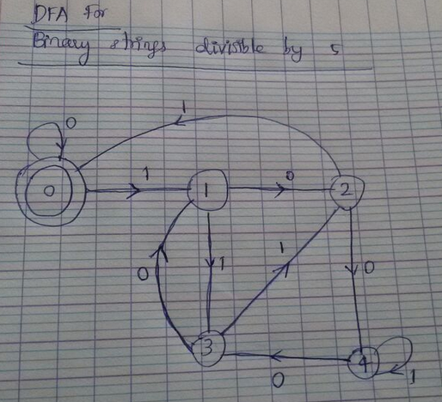
Question
Construct a DFA which accepts strings of 0’s and 1’s where the values of each string is represented as a binary number only. Only the strings representing zero modulo five should be accepted. For example 0, 101, 0101, 1010, 1111, 1101,………
OR
Design a DFA to accept the binary numbers which are divisible by 5

Slide 109
Question
The password to the admins account=”administrator”. The total number of states required to make a password-pass system using DFA would be __________ a) 14 states b) 13 states c) 12 states d) A password pass system cannot be created using DFA

Slide 110
Question
The password to the admins account=”administrator”. The total number of states required to make a password-pass system using DFA would be __________ a) 14 states b) 13 states c) 12 states d) A password pass system cannot be created using DFA
Answer: a Explanation: For a string of n characters with no repetitive substrings, the number of states required to pass the string is n+1.

Slide 111
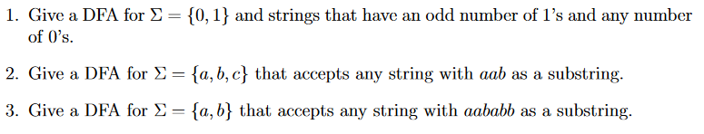
DFA Exercises

Slide 112
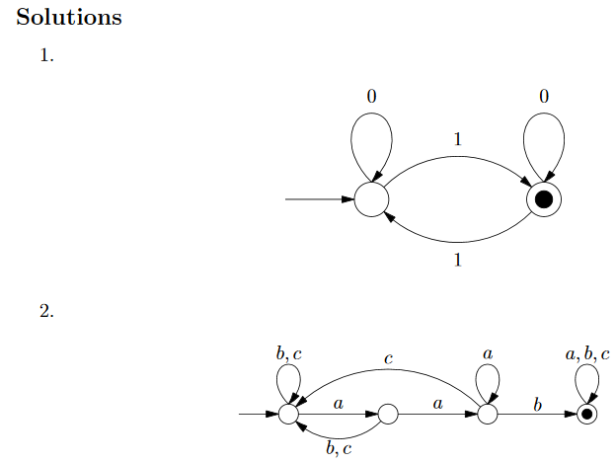

Slide 113
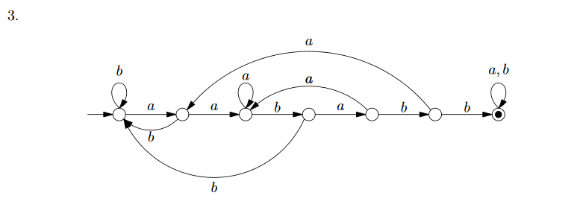

Slide 114
Examples
Construct a DFA that accepts the language
Answer
L = {010, 1}
( Σ = {0, 1} )
q₀
1
q₀₁
0
q₀₁₀
0
0
1
q_{ε}
0, 1
1
q₁
0, 1
q_{die}
0, 1

Slide 115
Examples
Construct a DFA over alphabet {0, 1} that accepts all strings that end in 101
Hint: The DFA must “remember” the last 3 bits of the string it is reading

Slide 116
Examples
Construct a DFA over alphabet {0, 1} that accepts all strings that end in 101
Sketch of answer:
0
0
q₀₀₀
0
q₀₀
1
1
q₀₀₁
q₀
0
1
…
q₀₁
…
q_{ε}
q₁₀
1
q₁₀₁
0
…
1
q₁
1
…
q₁₁
1
q₁₁₁
1

Slide 117
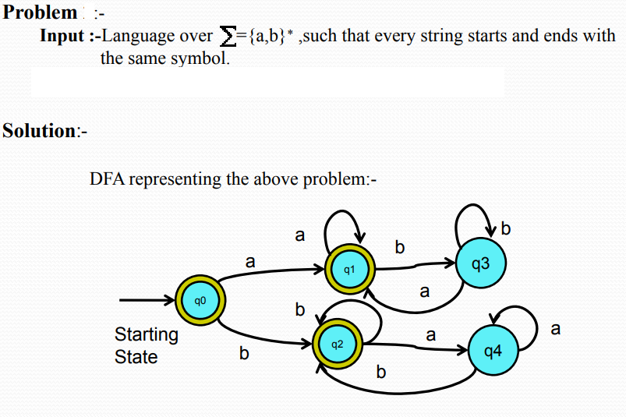

Slide 118
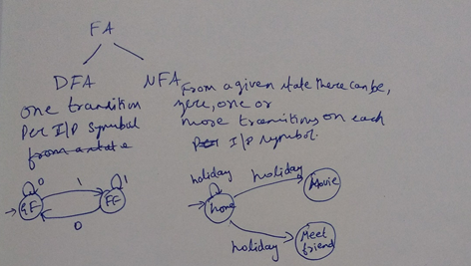
Unit-1
Nondeterministic Finite Automata (NFA)

Slide 119
Rough slide to explain Nondeterministic Finite Automata (NFA)
DFA: Set of all strings ending with ab over Σ ={a, b}
NFA: Set of all strings ending with ab over Σ ={a, b}

Slide 120

Nondeterministic Finite Automata
Non determinism gives a machine multiple options for its moves.

Slide 121

Nondeterministic Finite Automata
Suppose in life,
Whenever you had a choice, you could try both possibilities and live your life.
At the end, you would go back and choose the one that worked out the best.
Notes:
https://www.cs.unc.edu/~plaisted/comp455/slides/nfa2.2.pdf

Slide 122

Formal Definition of an NFA

Slide 123
Rough Slide to explain NFA formal definition
NFA: Set of all strings ending with ab over Σ ={a,b}

Slide 124

Example of NFA

Slide 125

NFA

Slide 126
Unit-1
Equivalence of NFA and DFA (or)
Converting NFA to DFA

Slide 127
Converting NFA to DFA using subset construction method Subset Construction Procedure
Given an NFA M_{NFA}= (Q _{nfa} , Σ, δ _{nfa}, q₀, F _{nfa}) which accepts the language L, find an equivalent DFA M_{DFA}= (Q _{dfa}, Σ, δ _{dfa} , q₀, F _{dfa}) such that
L(M_{NFA}) =L(M_{DFA})
Step-1: Identify the start state of the DFA . Since q_{o} is the start state of NFA, {q₀} is the start state of DFA
Step-2: Identify the alphabets of DFA. The input alphabets of NFA are the input alphabets of DFA
Step-3: Identify the Q_{DFA} , which are the states of DFA
The set of subsets of Q_{NFA} will be the states of DFA Q_{DFA}
Example:
Q_{NFA} ={q₀ , q₁ , q₂ }
Q_{DFA} ={∅ , {q₀} , {q₁} , {q₂}, {q₀ , q₁ } , {q₀ , q₂ } …..}

Slide 128
Converting NFA to DFA using subset construction method Subset Construction Procedure (Contd….)
Step-4: Identify the final states of DFA
If {q_{i} , q_{j}, …q_{k}} is the state of DFA then {q_{i} , q_{j}, …q_{k}} will be final state of DFA provided one of q_{i} , q_{j}, …q_{k} is the final state of NFA
Step-5: Identifying transitions of DFA
For each state {q_{i} , q_{j}, …q_{k}} in QDFA and for each input symbol ‘a’ in Σ , the transition can be obtained as shown below
δ_{DFA} ({q_{i} , q_{j}, …q_{k}} , a) = {δ_{NFA} (q_{i}, a) U δ_{NFA} (q_{j}, a) ……..}

Slide 129

Converting NFA to DFA using subset construction method

Slide 130
Rough Slide to explain: Obtain the NFA to accept strings of a’s and b’s ending with ab and convert into equivalent DFA
Converting NFA to DFA
NFA to accept strings ending with ab
a, b
M_{DFA}= (Q _{dfa}, Σ, δ _{dfa} , q₀, F _{dfa})
a
={a, b} , q₀ = { q₀ }
δ_{DFA} ({q_{i} , q_{j}, …q_{k}} , a) =
{δ_{NFA} (q_{i}, a) U δ_{NFA} (q_{j}, a) ……..}
q₀
q₁
b
q₂
M_{NFA}= (Q_{nfa} , Σ, δ _{nfa}, q₀, F _{nfa})
Q_{NFA} ={q₀,q₁,q₂}
={a, b} , q₀ = q₀ , F_{NFA}={q₂}
δ_{NFA}: Q × Σ → 2^{Q}
δ_{DFA} | a | b
Transition Table
δ_{NFA} | a | b
q₀ | {q₀, q₁} | {q₀}
q₁ | ∅ | {q_{2}}
q₂ | ∅ | ∅

Slide 131


Slide 132

δ_{NFA} | a | b
q₀ | {q₀, q₁} | {q₀}
q₁ | ∅ | {q_{2}}
q₂ | ∅ | ∅
δ_{DFA} ({q_{i} , q_{j}, …q_{k}} , a)=
{δ_{NFA} (q_{i}, a) U
δ_{NFA} (q_{j}, a) ……..}

Slide 133

Question
Convert the following NFA to a DFA

Slide 134

Question
Convert the following NFA to a DFA
Answer
*

Slide 135


Question

Slide 136

Answer

Slide 137

Answer
DFA

Slide 138
Question
Obtain NFA to accept strings of a’s and b’s ending with ab or ba and convert into equivalent DFA

Slide 139

Obtain NFA to accept strings of a’s and b’s ending with ab or ba and convert into equivalent DFA

Slide 140


Slide 141

Converting NFA to DFA using subset construction method

Slide 142

Question
Convert following NFA to its equivalent DFA

Slide 143

Answer
Convert following NFA to its equivalent DFA

Slide 144
Question
Subset Construction method refers to: a) Conversion of NFA to DFA b) DFA minimization c) Eliminating Null references d) e-NFA to NFA

Slide 145
Question
Subset Construction method refers to: a) Conversion of NFA to DFA b) DFA minimization c) Eliminating Null references d) e-NFA to NFA
Answer: a Explanation: The conversion of a non-deterministic automata into a deterministic one is a process we call subset construction or power set construction.

Slide 146
Questions
1. Obtain NFA for the language L={w / w ∈ abab^{n} or aba^{n} n>=0}
2. Design a NFA to accept the language which consists of string w ∈ {a,b}∗ which has aab as substring
3. Design a NFA that accepts the language L(aa*(a+b))
4. Design a NFA that accepts the language L={a³ U a^{2n}, n>=1}
5. Construct NFA for accepting the set of all strings whose second last symbol is 1 over the alphabet set Σ ={0,1}
6. Write NFA accepting all strings of 0’s and 1’ssuch that either second or third position from the end has 1.

Slide 147
Questions
1. Obtain NFA for the language L={w / w ∈ abab^{n} or aba^{n} n>=0}

Slide 148

Questions
1. Obtain NFA for the language L={w / w ∈ abab^{n} or aba^{n} n>=0}

Slide 149

Questions
2. Design a NFA to accept the language which consists of string w ∈ {a,b}∗ which has aab as substring

Slide 150

Questions
3. Design a NFA that accepts the language L(aa*(a+b))

Slide 151

Questions
4. Design a NFA that accepts the language L={a³ U a^{2n}, n>=1}

Slide 152
Questions
5. Construct NFA for accepting the set of all strings whose second last symbol is 1 over the alphabet set Σ ={0,1}
6. Write NFA accepting all strings of 0’s and 1’s such that either second or third position from the end has 1.

Slide 153


Questions
5. Construct NFA for accepting the set of all strings whose second last symbol is 1 over the alphabet set Σ ={0,1}
6. Write NFA accepting all strings of 0’s and 1’s such that either second or third position from the end has 1.

Slide 154

Question

Slide 155

Answer

Slide 156

Question

Slide 157

Answer

Slide 158

Homework Problem
Give an NFA over {0,1} that accepts the set of strings that contain an even number of substrings 01.

Slide 159


Slide 160


Slide 161


Slide 162

Homework Problem

Slide 163
Question
The number of states in the minimal deterministic finite automaton corresponding to the regular expression (0 + 1)*(10) is ____________ (A) 2 (B) 3 (C) 4 (D) 5 Answer: (B)
NFA
1
0

Slide 164

Question
Draw a deterministic and non-deterministic finite automata which accept a string containing “the” anywhere in a string of {a-z}, e.g., “there” but not “those”.

Slide 165

Question
Draw a deterministic and non-deterministic finite automata which accept a string containing “ing” at the end of a string in a string of {a-z}, e.g., “anything” but not “anywhere”.

Slide 166


Slide 167
Unit-1: Non-Deterministic Finite Automata (NFA) with ε-transitions
NFA with ε-transitions is a finite automata in which there are transitions from one state to other state even without taking input alphabet.

Slide 168
NFA with ε – Transitions: Formal Definition
NFA with ε –moves is a 5-tuple system
M_{E}= (Q, Σ, δ, q₀, F) where
Q is a finite set of states
Σ is an alphabet set or input symbols
q₀ ∈ Q is the initial (or start)state
F ⊆ Q is a set of accepting states (or final states).
δ: Q × ( Σ U ε ) → 2^{Q} is a transition function
δ (q , a) will consists of all states of p such that there is a transition labelled ‘a’ from q to p where ‘a’ is either ε or a symbol in Σ
Note:
- Transition in ε – NFA is allowed to make a transition spontaneously without receiving an input symbol.
- ε-NFA’s are closely related to regular expressions.
- ε-NFA’s are useful in proving the equivalence between the classes of language accepted by finite automate and by regular expressions

Slide 169
Rough slide to Explain example of ε-NFA
ε z-NFA that accepts decimal number consisting of
i. An optional + or - sign
ii. A string of digits
iii. A decimal point
iv. Another string of digits. Either this string of digits or the string can be empty, but at least one of the two strings of digits must be non empty.

Slide 170
Rough slide to Explain example of NFA without ε-moves
ε z-NFA that accepts decimal number consisting of
i. An optional + or - sign
ii. A string of digits
iii. A decimal point
iv. Another string of digits. Either this string of digits or the string can be empty, but at least one of the two strings of digits must be non empty.

Slide 171

NFA without ε-moves

Slide 172


Slide 173

Rough slide to explain:ε-Closure or Empty closure
ε-Closure of a state: It is a set of reachable states from a given state with ε-Transitions.
ε-Closure (q) = q U set of all states that can be
reached with ε

Slide 174

ε-Closure or Empty closure
ε-Closure of a state: It is a set of reachable states from a given state with ε-Transitions.
ε-Closure (q) = q U set of all states that can be
reached with ε

Slide 175

Question
Considering the following ε–NFA , compute the ε-closure of the states q₀, q₄ , q₁
q₃

Slide 176


Slide 177
Converting ε–NFA to DFA
Conversion procedure is very close to Subset construction procedure
Given an ε- NFA M_{E}= (Q_{e} , Σ, δ_{e} , q₀ , F_{e} ) which accepts the language L, find an equivalent DFA M_{D}= (Q_{d} , Σ, δ_{d} , q_{d} , F_{d} ) such that L(M_{E}) =L(M_{D})
Step-1: If q₀ is start state of ε–NFA then ε-Closure(q₀) is the start state of DFA i.e. , q_{d} = ε-Closure (q₀)
Step-2: Compute the transitions for DFA. Let {q_{i} , q_{j}, …q_{k}} be the state of DFA. Then, the transitions from this state on ‘a’ i.e. δ_{d}({q_{i} , q_{j}, …q_{k}} , a) is computed as shown below
- Let δ_{e}({q_{i} , q_{j}, …q_{k}} , a) ={P₁, P₂,……P_{m}}
- Then, take ε-Closure({P₁, P₂,……P_{m}})
Thus, δ_{d}({q_{i} , q_{j}, …q_{k}} , a) = ε-Closure(δ_{e}({q_{i} , q_{j}, …q_{k}} , a) )
Step-3: If {q_{i} , q_{j}, …q_{k}} is a state in DFA and if this set contains at least one final state of ε -NFA , then {q_{i} , q_{j}, …q_{k} } is the final state of DFA

Slide 178


Rough Slide to explain Converting ε-NFA to DFA
δ_{e} | + , - | . | 0-9 | ε
q₀ | {q₁} | ∅ | ∅ | {q₁}
q₁ | ∅ | {q₂} | {q₁ ,q₄} | ∅
q₂ | ∅ | ∅ | {q₃} | ∅
q₃ | ∅ | ∅ | {q₃} | {q₅}
q₄ | ∅ | {q₃} | ∅ | ∅
q₅ | ∅ | ∅ | ∅ | ∅

Slide 179

Rough Slide to explain Converting ε-NFA to DFA
M_{D}= (Q_{d} , Σ, δ_{d} , q_{d} , F_{d} )
= {. , + , − , 0, 1, 2, 3 ,4,5 ,6, 7, 8, 9}
δ_{d} | + , - | . | 0-9
q_{d} = ε -Closure(q₀)

Slide 180

Converting ε-NFA to DFA

Slide 181

Converting ε-NFA to DFA (Contd…)

Slide 182

Converting ε-NFA- to DFA

Slide 183


Slide 184


Slide 185


Slide 186
Difference between DFA, NFA, ε-NFA
DFA | NFA | ε-NFA
M= (Q, Σ, δ, q₀, F) where Q is a finite set of states Σ is an alphabet set or input symbols δ: Q × Σ → Q is a transition function q₀ ∈ Q is the initial (or start)state F ⊆ Q is a set of accepting states | M_{NFA}= (Q, Σ, δ, q₀, F) where Q is a finite set of states Σ is an alphabet set or input symbols q₀ ∈ Q is the initial (or start)state F ⊆ Q is a set of accepting states (or final states). δ: Q × Σ → 2^{Q} is a transition function | M_{E}= (Q, Σ, δ, q₀, F) where Q is a finite set of states Σ is an alphabet set or input symbols q₀ ∈ Q is the initial (or start)state F ⊆ Q is a set of accepting states (or final states). δ: Q × ( Σ U ε ) → 2^{Q} is a transition function
If a string w is accepted by DFA from state q, there will be exactly one path labelled w starting at q. Therefore, to determine if a string is accepted, it is sufficient to check for this one path. Following this path, if the machine is in final state, we say that the string w is accepted. Otherwise, the string is rejected | If a string w is accepted by NFA from state q, there will be many paths labelled w. Therefore, to determine if a string is accepted, it is necessary to check all these paths to see whether on or more terminate at final state. Following these path, if we reach a final state, the string is accepted else the string is rejected. | For ε-NFA, there may be many paths labelled w along with ε and all must be checked to see whether one or more terminate at final state. If the final state is reached, the given string w is accepted by the machine else it is rejected by the machine.
Difficult to construct | Easy to construct | Easy to construct using regular expression

Slide 187

Text Search using Automata

Slide 188


Slide 189


Slide 190


Slide 191


Slide 192
Thanks for Listening
Look for updates at Course Webpage:
https://sites.google.com/site/drvumadevi/teaching/tfc-jan-may-2020
No need to remember the webpage URL
Do Google Search -☺ – “Umadevi BMS”, you will find
teaching webpage

Slide 193
Homework Problems
1. Obtain a DFA to accept strings of 0’s , 1’s and 2’s beginning with a ‘0’ followed by odd number of 1’s and ending with ‘2’
2. Construct DFA for the following language over the alphabet set Σ ={0, 1}
L={w / w is even length and begins with ‘01’

Slide 194

Question
What is the complement of the language accepted by the NFA shown below? Assume ∑ = {a} and ε is the empty string
(A) Φ (B) ε (C) a (D) {a, ε}
Answer (B) The given alphabet ∑ contains only one symbol {a} and the given NFA accepts all strings with any number of occurrences of ‘a’. In other words, the NFA accepts a+. Therefore complement of the language accepted by automata is empty string.

